Slide 1

Banking Database Management
Course: Database Management 1
Instructor: Prof. Dr. Melike ŞahDirekoğlu
Group Members:
Farhaneh Aryanejad - 22101015
Amanuel Galema - 22316708
Nathan Ngoyi - 22116175
Joshua Omotosho - 22210133

Slide 2
Introduction
Banking database management is essential for efficient handling of customer and transaction data in the system.
We have designed the database to efficiently manage essential operations and ensure data integrity.
It connects core entities such as accounts, customers, employees, branches, loans, and transactions.
The schema supports critical functionalities like account management, loan processing, transaction tracking, and card services.
We have organized the structure to ensure seamless collaboration between various banking operations, enhancing overall efficiency and customer satisfaction.

Slide 3
The Database Design and Implementation Steps
Step One
Step Two
Step Three
Database Schema Design
Drawing The ERD
Data Definition Language
Banking Management
Step Four
Step Five
Data Manipulation Language
Related Queries

Slide 4
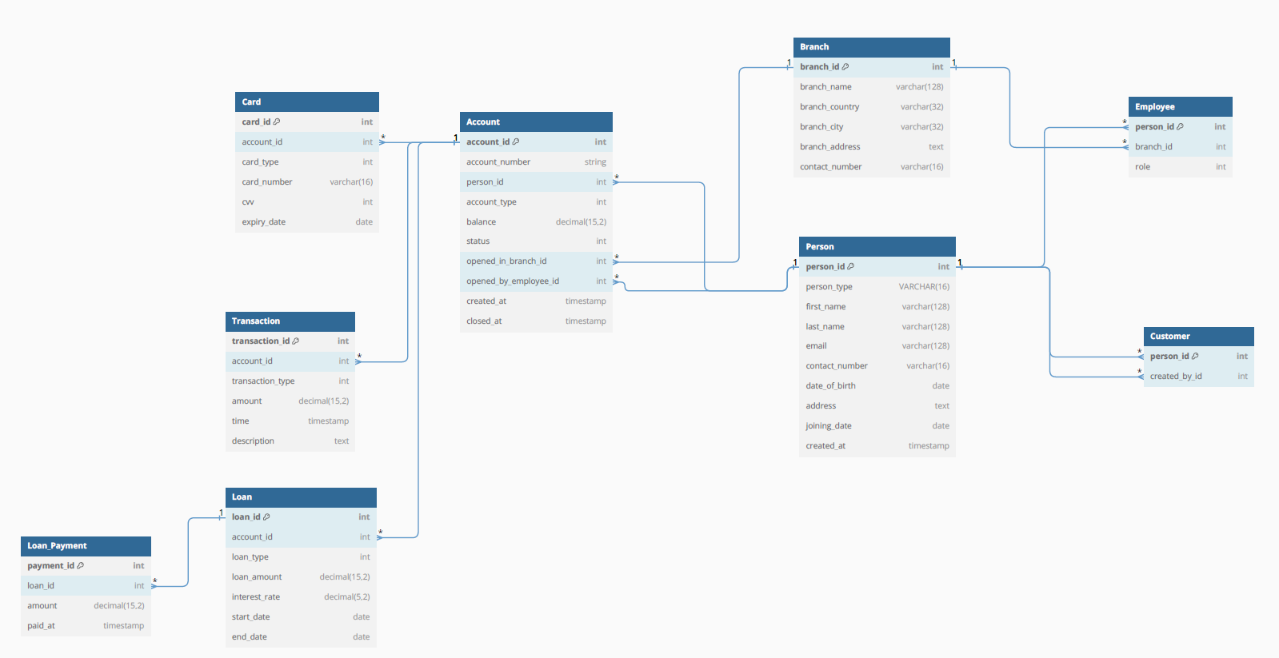
Step One : Database Schema Design
dbdiagram.io

Slide 5
ENTITIES : - PERSON, CUSTOMERS , ACCOUNTS, TRANSACTIONS, LOANS, LOANS PAYMENT , BRANCHES, EMPLOYEES, CARD . RELATIONSHIPS : - PERSON (PARENT) ARE LINKED TO CUSTOMER AND EMPLEYEE - CUSTOMERS CAN HAVE MULTIPLE ACCOUNTS IN DIFFERENT BRANCHES - AN ACCOUNT HAS A CARDS - EACH ACCOUNT CAN HAVE MULTIPLE TRANSACTIONS - LOANS ARE LINKED TO ACCOUNT AND BRANCHES - LOAN PAYMENT HAS LINKED TO LOANS - EMPLOYEES BELONG TO BRANCHES
Step Two : ERD (Entity Relationship Diagram)

Slide 6
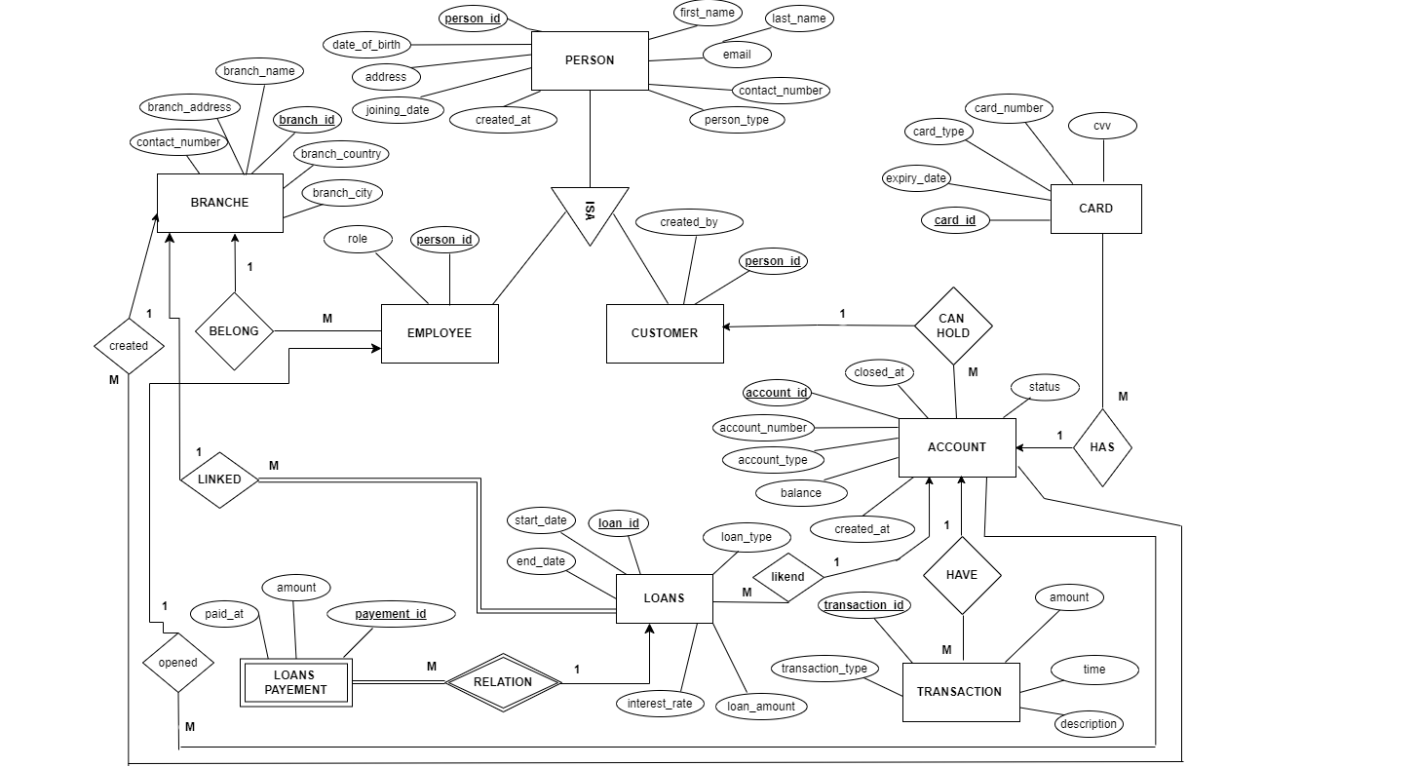

Slide 7
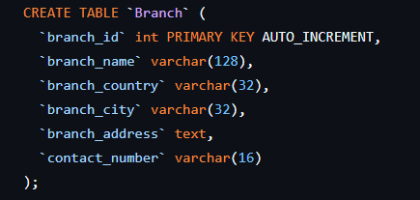
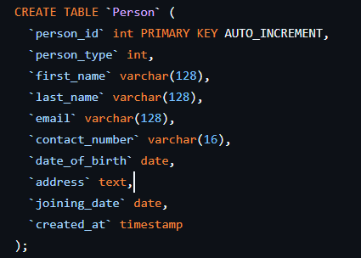
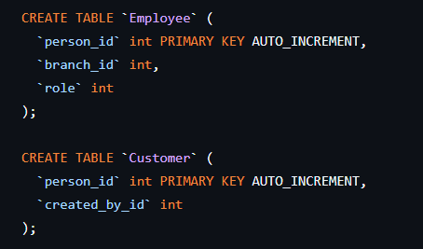
Step Three : Data Definition Language

Slide 8
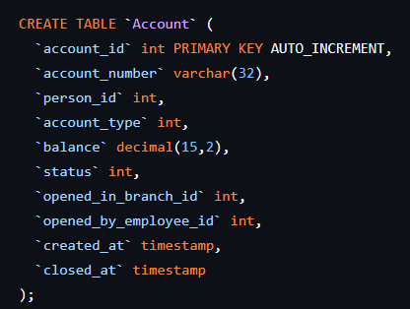
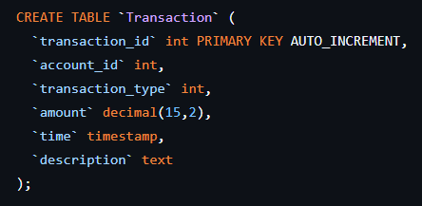
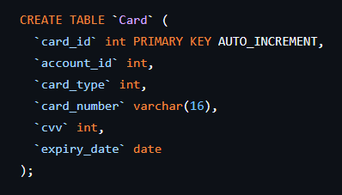
Step Three : Data Definition Language

Slide 9
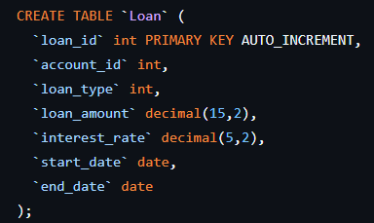
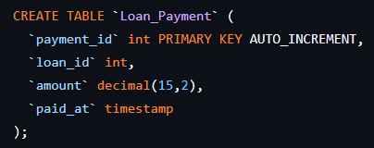
Step Three : Data Definition Language

Slide 10
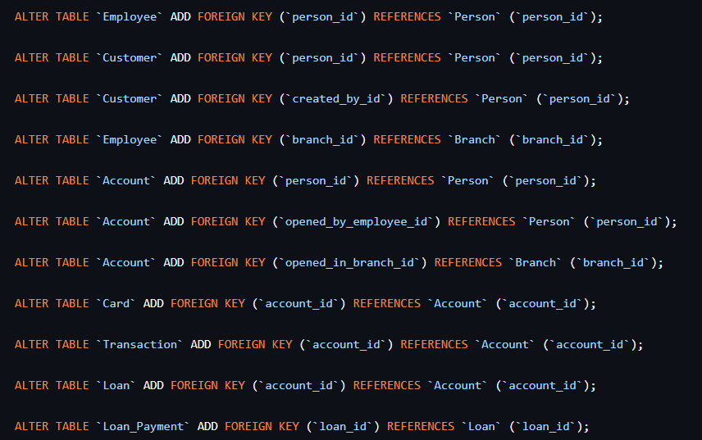
Step Three : Data Definition Language

Slide 11
Step Four : Data Manipulation Language
INSERT DATA FOR TABLE BRANCH
INSERT INTO "Branch" (branch_id, branch_name, branch_country, branch_city, branch_address, contact_number)
VALUES
(1, 'Central Branch', 'USA', 'New York', '100 Main Street', '+1-212-555-0101’),
(2, 'West Branch', 'USA', 'Los Angeles', '200 West Sunset Blvd', '+1-310-555-0102'),
(3, 'East Branch', 'USA', 'Boston', '300 Commonwealth Ave', '+1-617-555-0103'),
(4, 'North Branch', 'Canada', 'Toronto', '400 Maple Street', '+1-416-555-0104'),
(5, 'South Branch', 'USA', 'Miami', '500 Ocean Drive', '+1-305-555-0105'),
(6, 'London Branch', 'UK', 'London', '600 High Street', '+44-20-555-0106'),
(7, 'Paris Branch', 'France', 'Paris', '700 Rue de Rivoli', '+33-1-555-0107'),
(8, 'Berlin Branch', 'Germany', 'Berlin', '800 Unter den Linden', '+49-30-555-0108'),
(9, 'Tokyo Branch', 'Japan', 'Tokyo', '900 Shibuya Crossing', '+81-3-555-0109'),
(10, 'Sydney Branch', 'Australia', 'Sydney', '1000 George Street', '+61-2-555-0110');
INSERT DATA FOR TABLE ACCOUNT
INSERT INTO "Account" (account_number, person_id, account_type, balance, status, opened_in_branch_id, opened_by_employee_id, created_at, closed_at)
VALUES
('ACC-1001', 10001, 1, 1000.20, 1, 1, 10005, '2018-12-31', NULL),
('ACC-1002', 10009, 2, 2500.50, 1, 9, 10507, '2020-10-07', NULL),
('ACC-1003', 10011, 1, 501.00, 1, 3, 10015, '2019-05-10', NULL),
('ACC-1004', 10027, 2, 10000.00, 1, 4, 10036, '2021-11-02', NULL),
('ACC-1005', 10028, 2, 750.75, 1, 7, 10237, '2024-06-17', NULL),
('ACC-1006', 10051, 1, 220.00, 1, 6, 10171, '2023-02-24', NULL),
('ACC-1007', 10101, 2, 3000.00, 1, 5, 10109, '2022-09-30', NULL),
('ACC-1008', 10189, 1, 400.00, 1, 8, 10251, '2020-08-28', NULL),
('ACC-1009', 10194, 2, 9900.99, 1, 2, 10008, '2023-01-13', NULL),
('ACC-1010', 10266, 1, 50.00, 1, 10, 10532, '2018-04-16', NULL);

Slide 12
Step Four : Data Manipulation Language
INSERT DATA FOR TABLE PERSON
INSERT INTO "Person" (person_ID, first_name, last_name, email, contact_number, date_of_birth, address, person_type, joining_date, created_at)
VALUES
(10001, 'John', 'Peters', 'john.peters@bankexample.com', '+1-212-555-1001', '1979-04-15', '101 Park Ave, New York, USA', 'Customer', '2008-03-15', NOW()),
(10005, 'Jane', 'Smith', 'jane.smith@bankexample.com', '+1-310-555-1002', '1982-08-21', '202 West Blvd, Los Angeles, USA', 'Employee', '2009-07-10', NOW()),
(10008, 'Robert', 'Johnson', 'robert.johnson@bankexample.com', '+1-617-555-1003', '1975-11-30', '303 Beacon St, Boston, USA', 'Employee', '2007-05-25', NOW()),
(10009, 'Emily', 'Davis', 'emily.davis@bankexample.com', '+1-416-555-1004', '1985-01-05', '404 Maple Rd, Toronto, Canada', 'Customer', '2010-02-14', NOW()),
(10011, 'Michael', 'Wilson', 'michael.wilson@bankexample.com', '+1-305-555-1005', '1978-06-11', '505 Ocean Dr, Miami, USA', 'Customer', '2006-11-01', NOW()),
(10015, 'Karen', 'Brown', 'karen.brown@bankexample.com', '+44-20-555-1006', '1980-09-12', '606 Regent St, London, UK', 'Employee', '2011-09-10', NOW()),
(10027, 'David', 'Jones', 'david.jones@bankexample.com', '+33-1-555-1007', '1977-12-02', '707 Rue Cler, Paris, France', 'Customer', '2005-04-30', NOW()),

Slide 13
Step Four : Data Manipulation Language
(10028, 'Linda', 'Garcia', 'linda.garcia@bankexample.com', '+49-30-555-1008', '1983-03-19', '808 Alexanderplatz, Berlin, Germany', 'customer', '2012-12-12', NOW()),
(10036, 'Mark', 'Miller', 'mark.miller@bankexample.com', '+81-3-555-1009', '1976-10-27', '909 Shinjuku, Tokyo, Japan', 'Employee', '2008-08-08', NOW()),
(10051, 'Patricia', 'Taylor', 'patricia.taylor@bankexample.com', '+61-2-555-1010', '1981-07-16', '1010 Darling St, Sydney, Australia', 'Customer', '2009-04-04', NOW()),
(10101, 'Alice', 'Anderson', 'alice.anderson@example.com', '+1-212-555-2001', '1990-03-14', '1101 Broadway, New York, USA', 'Customer', '2020-01-10', NOW()),
(10109, 'Peter', 'Thomas', 'peter.thomas@example.com', '+1-310-555-2002', '1992-05-29', '1202 Vine St, Los Angeles, USA', 'Employee', '2020-02-15', NOW()),
(10171, 'Susan', 'Jackson', 'susan.jackson@example.com', '+1-617-555-2003', '1988-11-03', '1303 Commonwealth Ave, Boston, USA', 'Employee', '2020-03-20', NOW()),
(10189, 'Daniel', 'White', 'daniel.white@example.com', '+1-416-555-2004', '1991-09-07', '1404 King St, Toronto, Canada', 'Customer', '2020-04-25', NOW()),
(10194, 'Sarah', 'Harris', 'sarah.harris@example.com', '+1-305-555-2005', '1989-01-12', '1505 Collins Ave, Miami, USA', 'Customer', '2020-05-30', NOW()),
(10237, 'Jessica', 'Martin', 'jessica.martin@example.com', '+44-20-555-2006', '1993-07-08', '1606 Baker St, London, UK', 'Employee', '2020-06-05', NOW()),

Slide 14
Step Four : Data Manipulation Language
(10251, 'Thomas', 'Thompson', 'thomas.thompson@example.com', '+33-1-555-2007', '1994-12-19', '1707 Montparnasse, Paris, France', 'Employee', '2020-07-10', NOW()),
(10266, 'Maria', 'Moore', 'maria.moore@example.com', '+49-30-555-2008', '1996-04-01', '1808 Potsdamer Platz, Berlin, Germany', 'Customer', '2020-08-15', NOW()),
(10507, 'James', 'Clark', 'james.clark@example.com', '+81-3-555-2009', '1995-02-23', '1909 Ginza, Tokyo, Japan', 'Employee', '2020-09-20', NOW()),
(10532, 'Laura', 'Lee', 'laura.lee@example.com', '+61-2-555-2010', '1993-06-14', '2010 Circular Quay, Sydney, Australia', 'Employee', '2020-10-10', NOW());

Slide 15
Step Four : Data Manipulation Language
ATTRIBUTE PERSON_TYPE CHANGE FROM INTEGER TO VARCHAR
ALTER TABLE "Person"
ALTER COLUMN person_type
SET DATA TYPE VARCHAR(16);
ENSURE NO DUPLICATE EMAIL IN THE PERSON TABLE
ALTER TABLE "Person"
ADD CONSTRAINT unqiue_email UNIQUE(email);
ENSURE NO DUPLICATE CONTACT_NUMBER IN THE PERSON TABLE
ALTER TABLE "Person"
ADD CONSTRAINT unqiue_contact UNIQUE(contact_number);

Slide 16
Step Four : Data Manipulation Language
INSERT DATA FOR TABLE EMPLOYEE
INSERT INTO "Employee" (person_id, branch_id, role)
VALUES
(10005, 1, 01),
(10008, 2, 02),
(10015, 3, 01),
(10036, 1, 02),
(10109, 5, 01),
(10171, 6, 01),
(10237, 1, 02),
(10251, 8, 01),
(10507, 9, 02),
(10532, 10, 01);
INSERT DATA FOR TABLE CUSTOMER
INSERT INTO "Customer" (person_id, created_by_id)
VALUES
(10001, 10532),
(10009, 10532),
(10011, 10532),
(10027, 10109),
(10028, 10251),
(10051, 10532),
(10101, 10532),
(10189, 10507),
(10194, 10015),
(10266, 10036);

Slide 17
Step Four : Data Manipulation Language
INSERT DATA FOR TABLE CARD
INSERT INTO "Card" (account_id, card_type, card_number, cvv, expiry_date)
VALUES
('1', 1, '4111111111111111', 123, '2025-12-31'),
('2', 1, '5500000000000004', 456, '2025-11-30'),
('3', 2, '4111111111111112', 234, '2026-10-31'),
('4', 2, '5500000000000005', 567, '2025-09-30'),
('5', 1, '4111111111111113', 345, '2026-08-31'),
('6', 1, '4111111111111114', 678, '2025-07-31'),
('7', 2, '5500000000000006', 789, '2026-06-30'),
('8', 1, '4111111111111115', 890, '2025-05-31'),
('9', 2, '5500000000000007', 901, '2026-04-30'),
('10', 1, '4111111111111116', 321, '2026-03-31');
INSERT DATA FOR TABLE TRANSACTION
INSERT INTO "Transaction" (account_id, transaction_type, amount, time, description)
VALUES
('8', 1, 100.00, ('2024-02-21 09:10:05'), 'Initial Deposit'),
('7', 2, 50.00, ('2022-07-18 12:22:41'), 'ATM Withdrawal'),
('1', 1, 500.00, ('2024-12-31 11:56:26'), 'ACH Deposit'),
('9', 1, 200.00, ('2023-10-27 08:15:03'), 'Check Deposit'),
('3', 2, 100.00, ('2024-05-10 07:27:15'), 'Online Purchase'),
('2', 1, 300.00, ('2021-12-12 10:48:00'), 'Cash Deposit'),
('4', 2, 150.00, ('2022-08-14 11:07:52'), 'Bill Payment'),
('5', 3, 1000.00, ('2024-09-09 00:12:38'), 'Wire Transfer In'),
('10', 2, 200.00, ('2020-11-01 12:55:11'), 'Debit Card Purchase'),
('6',1, 400.00, ('2023-12-07 10:31:22'), 'Mobile Deposit');

Slide 18
Step Four : Data Manipulation Language
INSERT DATA FOR TABLE LOAN
INSERT INTO "Loan" (account_id, loan_id, loan_type, loan_amount, interest_rate, start_date, end_date)
VALUES
('2', 0290, 1, 5000.00, 5.00, '2024-01-30', '2026-01-29'),
('7', 1059, 1, 10000.00, 4.50, '2024-02-19', '2027-02-18'),
('4', 0001, 2, 250000.00, 3.25, '2024-03-09', '2030-03-08'),
('6', 2832, 1, 2000.00, 6.00, '2024-04-15', '2025-04-14'),
('1', 2010, 2, 150000.00, 3.50, '2024-05-08', '2028-05-07'),
('3', 4372, 1, 7500.00, 5.25, '2024-06-20', '2027-06-19'),
('10', 3904, 2, 300000.00, 3.00, '2024-07-16', '2029-07-15'),
('5', 8392, 1, 4000.00, 5.75, '2024-08-31', '2026-08-01'),
('8', 2013, 1, 12000.00, 4.75, '2024-09-18', '2026-09-17'),
('9', 2387, 2, 200000.00, 3.20, '2024-10-11', '2031-10-10');
INSERT DATA FOR TABLE LOAN_PAYMENT
INSERT INTO "Loan_Payment" (payment_id, amount, paid_at)
VALUES
(0290, 500.00, '2024-04-29'),
(2832, 600.00, '2024-06-14'),
(2387, 2000.00, '2024-11-10'),
(1059, 250.00, '2025-12-18'),
(2010, 1500.00, '2027-12-07'),
(8392, 750.00, '2026-10-01'),
(0001, 30000.00, '2028-05-08'),
(3904, 400.00, '2029-02-15'),
(2013, 1200.00, '2025-03-17'),
(4372,2000.00, '2025-01-19');

Slide 19
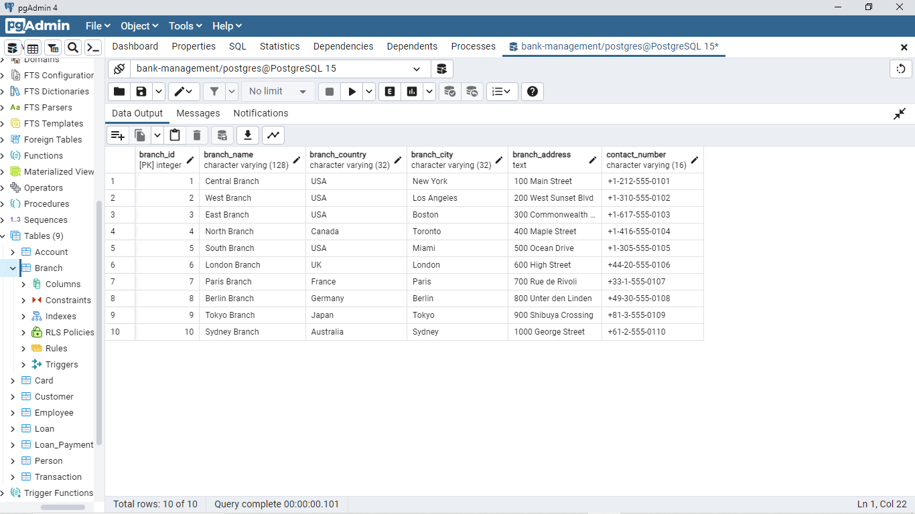
Sample Tables

Slide 20
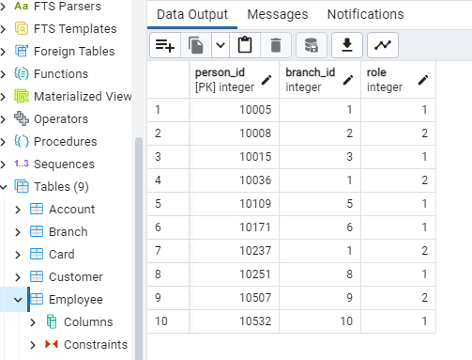
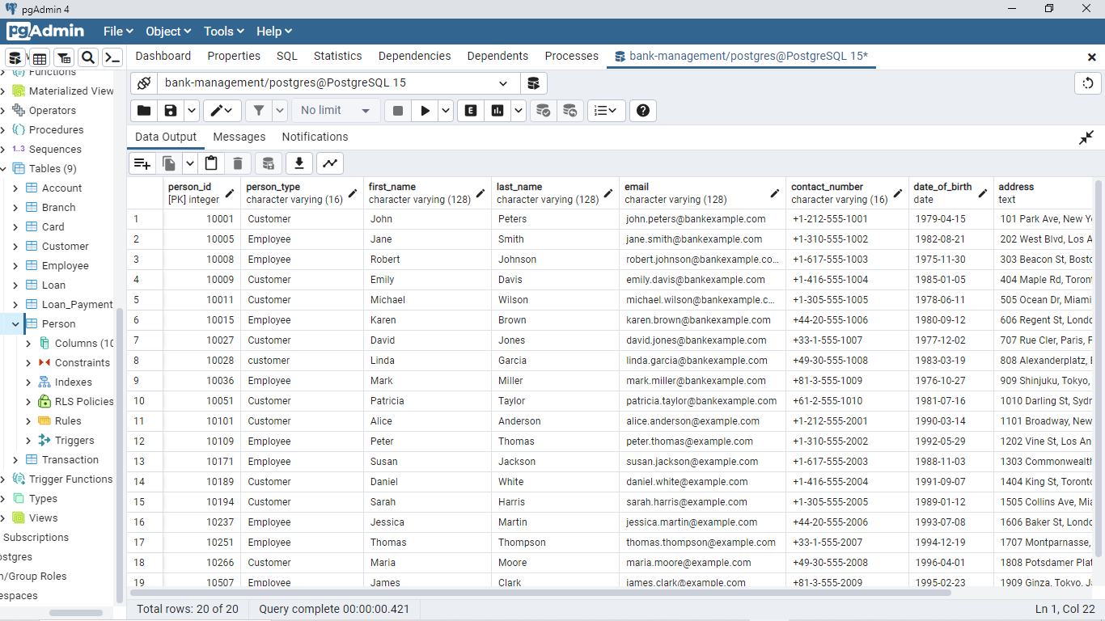
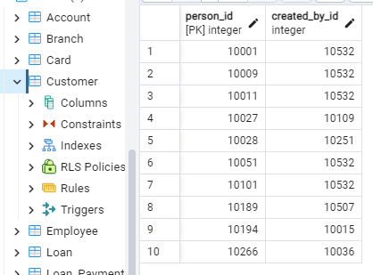
Sample Tables

Slide 21
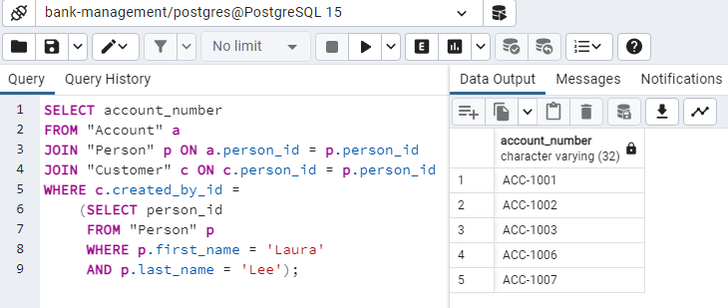
Step Five : Related Queries
Account number of all accounts opened by Laura Lee

Slide 22
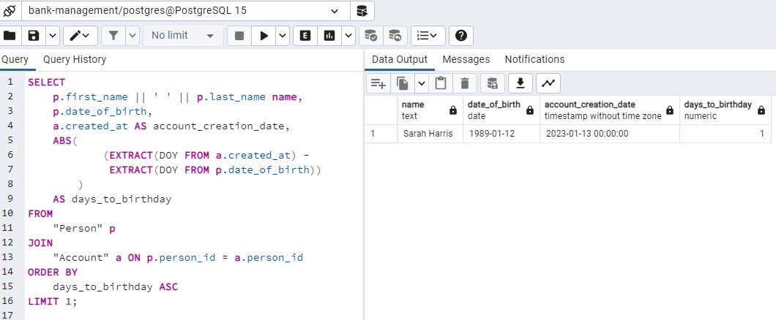
Step Five : Related Queries cont.
Find a person who created an account very close to or on the same day as their birthday

Slide 23
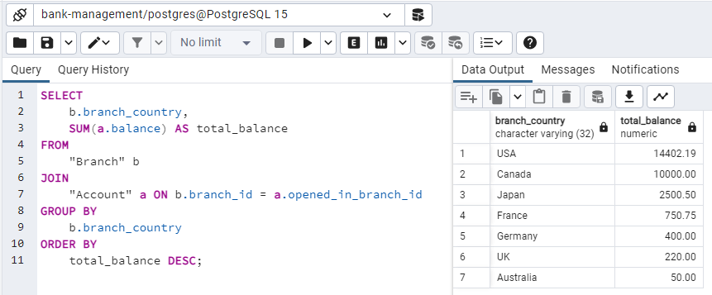
Step Five : Related Queries cont.
Find out which country has the highest total account balance by grouping accounts by countries

Slide 24
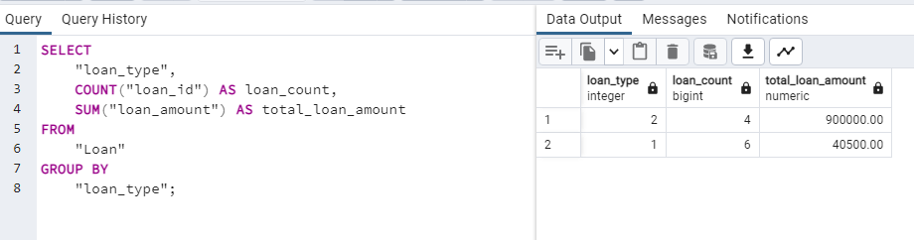
Step Five : Related Queries cont.
Find the number of loans taken and the total loan amount by loan type

Slide 25
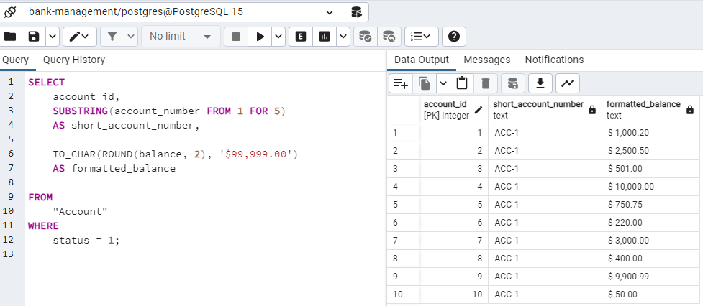
Step Five : Related Queries cont.
List the shortened version of the account number (first 5 characters), and the formatted balance of all active accounts.

Slide 26
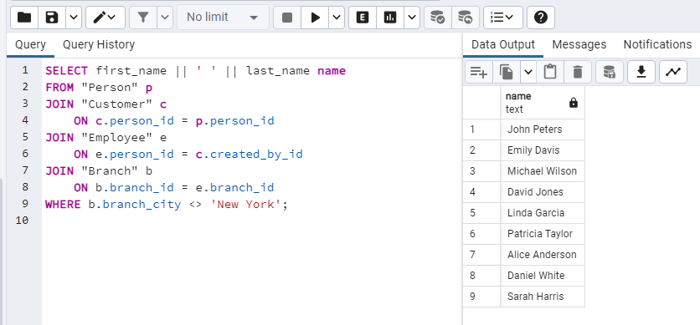
Step Five : Related Queries cont.
List the name of all customers who haven't opened account in New York

Slide 27
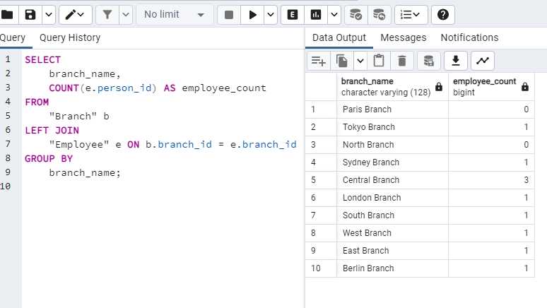
Step Five : Related Queries cont.
List all branches with the number of employees in each branch

Slide 28
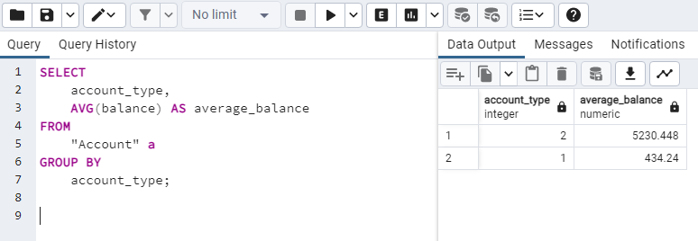
Step Five : Related Queries cont.
Calculate the average account balance by account type

Slide 29
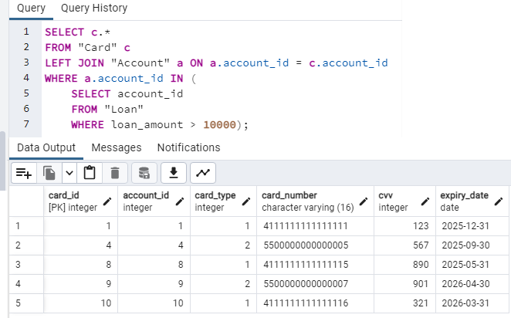
Step Five : Related Queries cont.
List card information of all customers with an outstanding loan above 10000

Slide 30
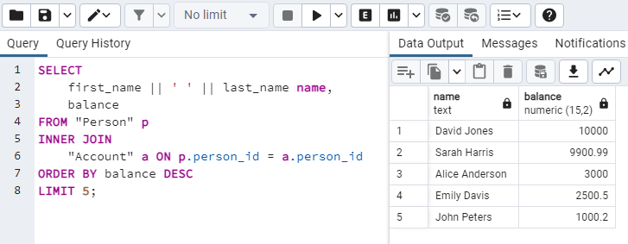
Step Five : Related Queries cont.
Find the top 5 customers with the highest account balances

Slide 31
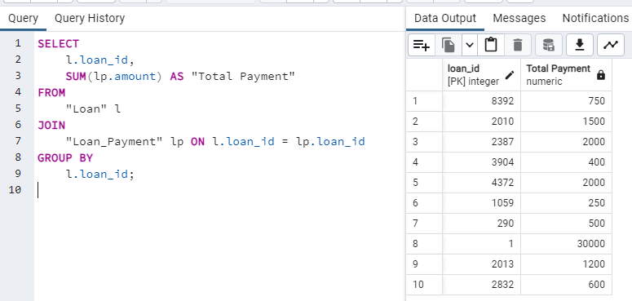
Step Five : Related Queries cont.
Display the total loan payments made for each loan.

Slide 32
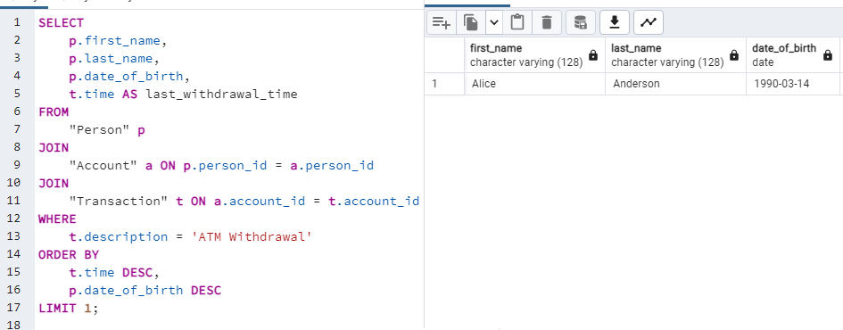
Step Five : Related Queries cont.
Find the last transaction of youngest person who withdrew money from an ATM

Slide 33
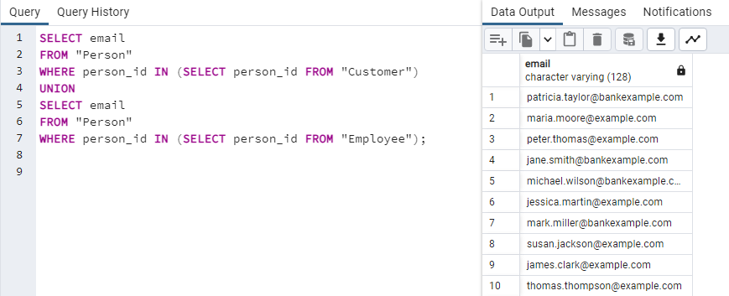
Step Five : Related Queries cont.
Combine Customers and Employees' Emails

Slide 34
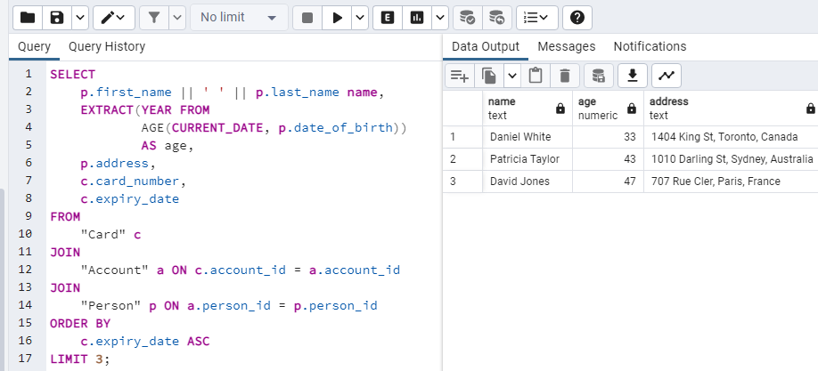
Step Five : Related Queries cont.
Find the name, age, and address of cardholders for the three cards expiring soonest

Slide 35
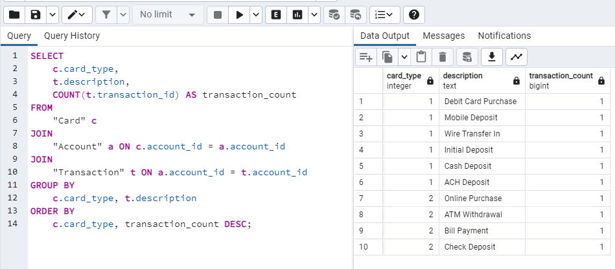
Step Five : Related Queries cont.
Group cards by their type and finds the most common transaction type for each card type

Slide 36
Thank You For Your Attention.

